Slide 1
J. D. Powers 2017 north America airport satisfaction study Overview September 2017
44,659 Online Surveys Completed
Conducted by three independent survey panel companies
60 airports total: LAX compared with 18 mega-airports (32M+ passengers annually)
1,000+ surveys for LAX (minimum of 850-900 for mega-airports)
Surveys screened for flight validity and other qualifying criteria
Possible 270 questions: respondents responses determined which questions they received
Example: If respondents indicated they arrived by Uber, they would not receive parking-related questions
Most respondents traveled within the past 30 days, all traveled within the past 90 days
Annual Survey Period
2015: September 2015 – October 2015
2016: November 2015 – October 2016
2017: November 2016 – July 2017
2018: August 2017 – July 2018 (Shifting to a new cycle)

Slide 2
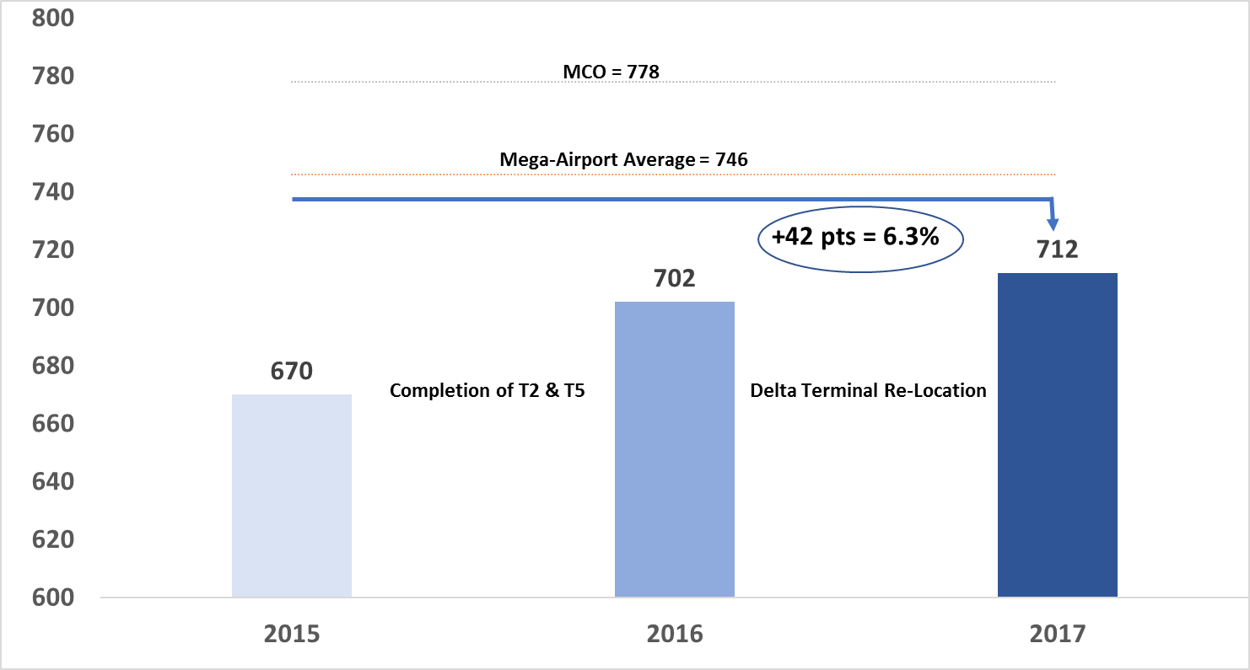
Despite construction challenges, lax j. d. powers ratings continue to improve

